Slide 1
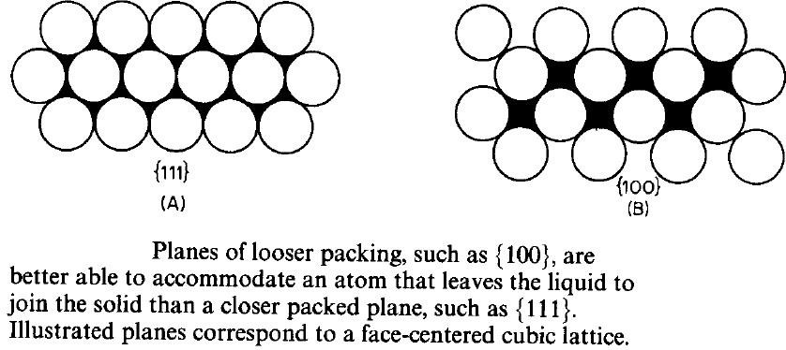

Planes of looser atomic packing can better accommodate an atom that leaves the
liquid. Where a growing crystal will assume faces that represent slow growing planes.
The shape of a growing crystal can be affected by the fact that different crystal
faces have different growth rates. Close-packed low-energy faces
tend
to grow
growing
slower and,
crystallite.
as
a
result,
they
are
the
ones
that
are
mostly
present
in
a
Figure 8
1

Slide 2
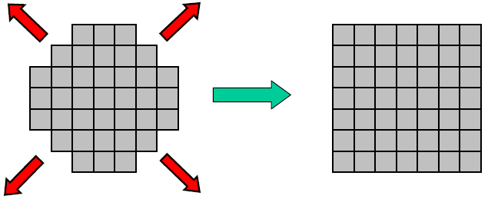
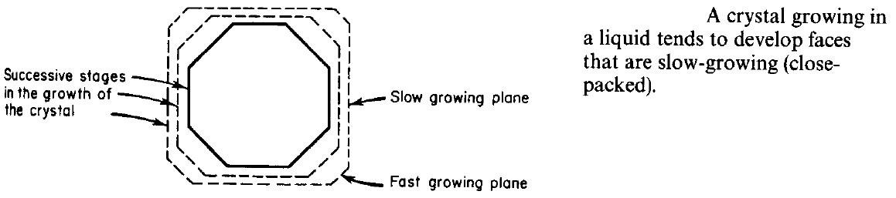
Figure 9
Total rate of a phase transformation induced by cooling is a product of the
nucleation rate (driving force increases with undercooling but diffusion needed for
atomic rearrangement slows down with T decrease) and growth rate (diffusion
controlled - slows down with T decrease) Figure 10.
At high T (close to Tm): low nucleation and high growth rates → coarse
microstructure with large grains.
At low T (strong undercooling): high nucleation and low growth rates → fine
structure with small grains.
2

Slide 3
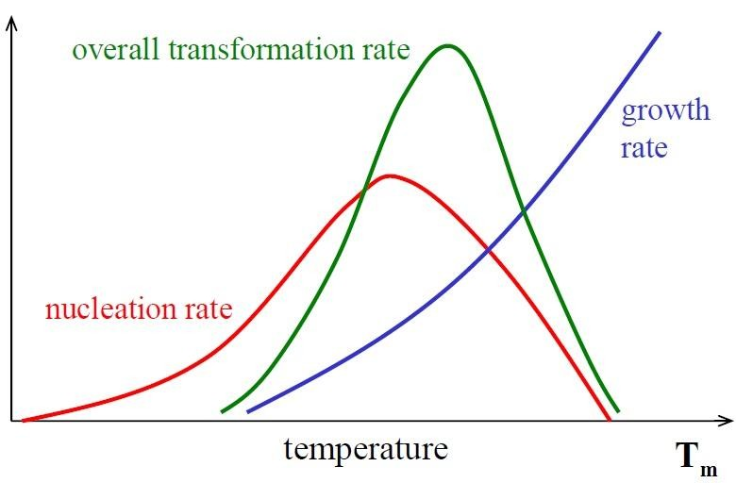

Figure 10
3

Slide 4
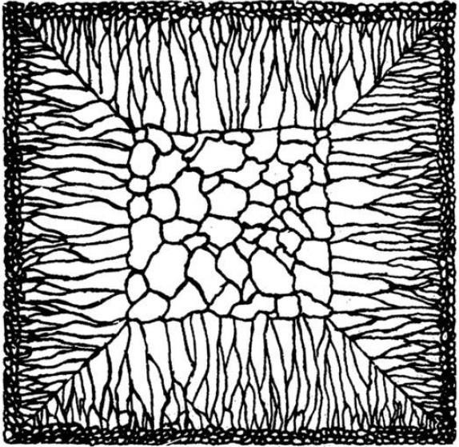
Grains Structure of Ingots and Castings
Most engineering alloys begin by casting process. If the as-cast pieces are
permitted to retain their shape afterwards, or are reshaped by machining, they are called castings. If they are later to be worked, e.g. by rolling, extrusion or forging, the pieces are called ingots. In either case the principles of solidification are the same.
Generally speaking three different zones can be distinguished in solidified alloy
ingots (Figure 11). These zones are (i) chill zone of equiaxed crystals,
columnar zone of elongated grains, and (iii) a central equiaxed zone.
(ii)
a
Figure 11
Chill Zone:
During pouring the liquid in contact with the cold mould wall is rapidly
cooled
below the liquidus temperature. Many solid nuclei then form on the mould wall
and begin to grow into the liquid, (Figure 12). As the mould wall warms up it is possible for many of these solidified crystals to break away from the wall under the
4

Slide 5
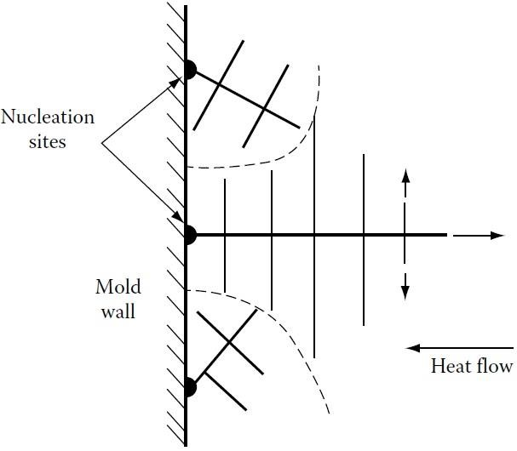
influence of the turbulent melt. If the pouring temperature is low the whole of the
liquid will be rapidly cooled below the liquidus temperature and the crystals swept
into the melt may be able to continue to grow. This is known as ‘big-bang’
nucleation since the liquid is immediately filled with a myriad of crystals. This
produces an entirely equiaxed ingot structure, i.e. no columnar zone forms, this
also can be done by adding seeds or inoculants which are a solid small particles
added to molten metal in the mold. If the pouring temperature is high, on the other
hand, the liquid in the centre of the ingot will remain above the liquidus
temperature for a long time and consequently the majority of crystals soon remelt
after breaking away from the mould wall. Only those crystals remaining close to
the wall will be able to grow to form the chill zone.
Figure 12
Columnar Zone
Very soon after pouring the temperature gradient at the mould walls decreases and
the crystals in the chill zone grow dendritically in certain crystallographic directions, e.g. <100> in the case of cubic metals. Those crystals with a <100>
5

Slide 6
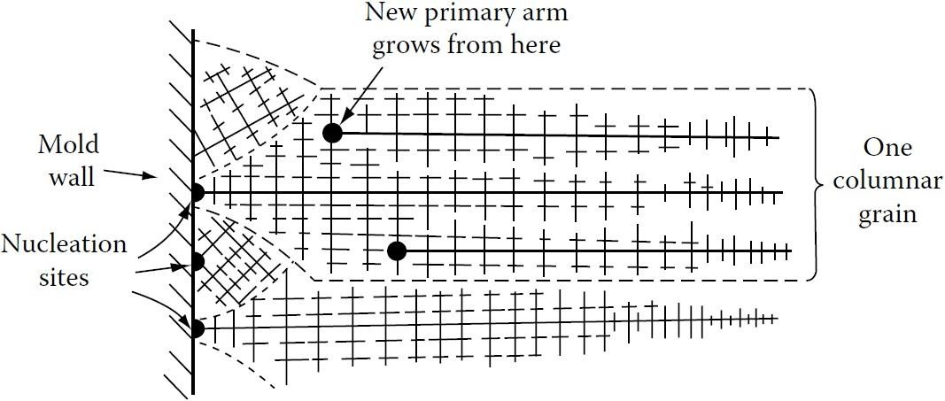

direction close to the direction of heat flow, i.e. perpendicular to the mould walls,
grow fastest and are able to outgrow less favourably oriented neighbours (Figure
13). This leads to the formation of the columnar grains all with <100> almost
parallel to the column axis. Note that each columnar crystal may contain primary
dendrite arms (if it is an alloy). As the diameter of these grains increases additional
primary dendrite arms appear by a mechanism in which some tertiary arms grow
ahead of their neighbours as shown in the figure.
Figure 13
Equiaxed Zone
The equiaxed zone consists of equiaxed grains randomly oriented in the centre of
the ingot. An important origin of these grains is thought to be melted-off dendrite
side-arms. It can be seen that the side arms are narrowest at their roots. Therefore,
if the temperature around the dendrite increases after it has formed, it will begin to
melt and may become detached from the main stem. Provided the temperature falls
again before the arm completely disappears it can then act as a ‘seed’ for a new
dendrite. An effective source of suitable temperature pulses is provided by the
6

Slide 7
turbulent convection currents in the liquid brought about by the temperature
differences across the remaining melt. Convection currents also provide a means of
carrying the melted-off arms away to where they can develop uninhibited into
equiaxed dendrites. If convection is reduced, fewer seed crystals are created
causing a larger final grain size and a greater preponderance of columnar grains.
Shrinkage Effects
Most metals shrink on solidification and this has important consequences for the
final ingot structure. In pure metals, and also in narrow freezing range alloys
(where the mushy zone is also narrow); as the outer shell of solid thickens the level
of the remaining liquid continually decreases until finally when solidification is
complete the ingot contains a deep central cavity or pipe. In alloys with a wide
freezing range the mushy zone can occupy the whole of the ingot. In this case no
central pipe is formed. Instead the liquid level gradually falls across the width of
the ingot as liquid flows down to compensate for the shrinkage of the dendrites.
However, as the inter-dendritic channels close up, this liquid flow is inhibited so
that the last pools of liquid to solidify leave small voids or porosities.
7

Slide 8
Segregation in Ingots and Castings
Two types of segregation can be distinguished in solidified structures. There is
macrosegregation, i.e. composition changes over distances comparable to the size of the specimen, and there is microsegregation that occurs on the scale of the secondary dendrite arm spacing.
There are four important factors that can lead to macrosegregation in ingots. These
are: (i) shrinkage due to solidification and thermal contraction; (ii) density
differences in the inter-dendritic liquid; (iii) density differences between the solid
and liquid; and (iv) convection currents driven by temperature-induced density
differences in the liquid. All of these factors can induce macrosegregation by
causing mass flow over large distances during solidification.
Shrinkage effects can give rise to what is known as inverse segregation. As the
columnar dendrites thicken solute-rich liquid [assuming (partitioning constant) k <
1] must flow back between the dendrites to compensate for shrinkage and this
raises the solute content of the outer parts of the ingot relative to the centre. The
effect is particularly marked in alloys with a wide freezing range, e.g. Al–Cu and
Cu–Sn alloys.
Interdendritic liquid flow can also be induced by gravity effects. For example
during the solidification of Al–Cu alloys the copper rejected into the liquid raises its density and causes it to sink. The effect can be reinforced by convection currents driven by temperature differences in the ingot.
Gravity effects can also be observed when equiaxed crystals are forming. The solid
is usually denser than the liquid and sinks carrying with it less solute than the bulk
composition (assuming k < 1). This can, therefore, lead to a region of negative
segregation near the bottom of the ingot.
8

Slide 9
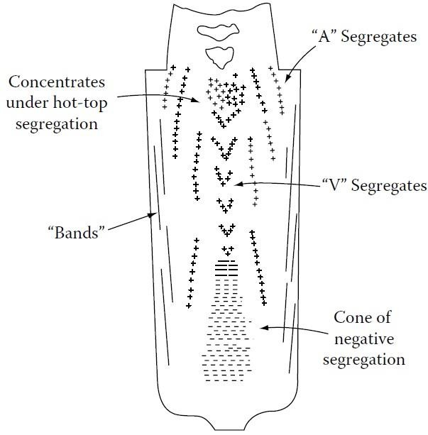
The combination of all the above effects can lead to complex patterns of
macrosegregation. Figure 14 for example illustrates the segregation patterns found in large steel ingots.
In general segregation is undesirable as it has marked deleterious effects on
mechanical properties. The effects of microsegregation can be mitigated by subsequent homogenization heat treatment, but diffusion in the solid is far too slow
to be able to remove macrosegregation
control of the solidification process.
which
can
only
be
combated
by
good
Figure 14
9

